Slide 1
Circular Economy in Agribusiness Sector
Innovative technologies for climate change mitigation by Mediterranean agricultural sector– Clima MED
LIFE17 CCM/GR/000087
https://life-climamed.eu/home

Slide 2
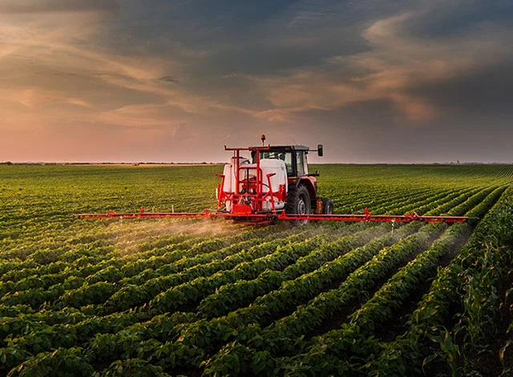
Current Production
9.3 billion tones crop production
4 trillion cubic meters of water
2,6 million tons pesticides
200 million tons fertilizers
47.4 square kilometers cultivated land area
77% used for livestock feed production
31 billion livestock

Slide 3
Linear Economy
Resource Extraction
Production
Distribution
Consumption
Waste
Approach
‘Take – Make – Use - Waste’ Raw materials are extracted and processed into products oriented for consumption. After being used, the consumers dispose any residuals as waste (landfills or incineration)
Vision
The value of linear system is based on mass manufacturing and product sales, prioritizing profit
Sustainability Approach
Focus towards eco-efficiency, trying to maintain production capacity while reducing the environmental impact. Puts an immerse pressure on scarce resources, that will eventually run out (downcycling)
Business Model
Focused on products

Slide 4
Circular Economy
Production
Distribution
Consumption
Recycle/ Reuse
Recycling Sector
Approach
Utilize products the longer possible, by practicing the 3R principle: Reduce, Reuse, Recycle. Designed to minimize waste and maximize resource use
Vision
Long-term vision, considering sustainability throughout the products’ life-cycle
Sustainability Approach
Aims towards eco-effectiveness, where the environmental impact is eliminated and positive economic, ecological or social impact is created when possible. The principle is to add value in materials and products (upcycling)
Business Model
Focuses in providing services. Has also the possibility to create new business opportunities and promote economic growth
Circular economy comprises of two parts; the biological and technical cycle
Also known as closed-loop system

Slide 5
Biological Cycle
Production
Product
Consumption/ Use
Bio-degradation
Nutrients
Plants
Involves materials that are easily biodegradable and can safely return to land. Biological waste is collected and re-enters the cycle in different ways
After the implementation of higher-value approaches, there are two main pathways in biological cycle:
  Anaerobic digestion: waste and manure produced by livestock’ are processed and release methane that converts into biogas production (renewable energy) and organic matter used as organic fertilizer
  Composting: Food waste, manure and crop residues are composted and return to land, adding nutrients and improving soil fertility. Composting is aerobic digestion and releases CO2 into the atmosphere
At the end of the cycle plants absorb the nutrients to grow and the cycle repeats

Slide 6
Technical Cycle
Manufacture
Materials
Reuse
Use
Products
The technical cycle is about products that are used, not consumed. Materials are refined or manufactured and looks on how materials can remain in use. Below circular strategies are illustrated in order of importance.
  Sharing: People tend to buy products that use only temporary. Sharing or rental services of goods can also increase social usefulness.
  Reuse/Redistribute: Reusing a product for different or same purpose. Redistributing products no longer needed to another target.
  Refurbish/ Remanufacture: Products are designed in a way that are easy to repair or remanufactured. Refurbish includes the replacement or repair of components to keep the product in use. Remanufacture returns a used product after intensive work in a like-new state and with the same or improved performance than when it was new
  Recycling: Recycling is used as a last resort in circular economy

Slide 7
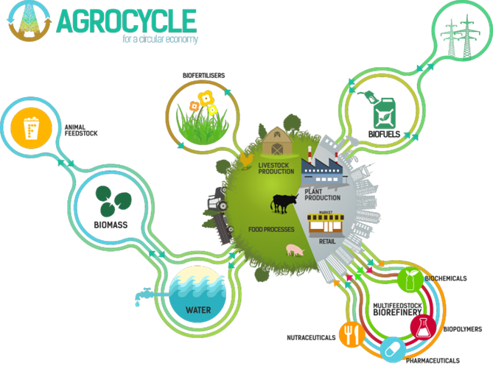
Circular in Agribusiness Sector
The science, art, or practice of cultivating the soils, producing crops and raising livestock in which resource use is optimized in closed loops and the systems are powered by renewable resources.

Slide 8

Circular Economy Principles
Eliminating Waste and Pollution
The pollution of air, land and water should be avoided. Chemicals are replaced by natural products or processes when available and renewable energy is utilized. Processes and technologies that extend products shelf life can further reduce food waste.
Preserve value over time
Products design aims to keep them in the technical cycle as long as possible. Biological materials should effectively be used and return to nature for regeneration
Regeneration of Nature
Employ farming practices that rebuild soils, regenerate forests, increase biodiversity and returns valuable nutrients back to the natural system.

Slide 9
Benefits of Circular Agriculture
  Has the potential for net-zero emissions or even positive environmental impact
  Efficient use of resources minimizing the cost of farming inputs
  The feedback-rich system can improve soil fertility and biodiversity, having the potential to reduce the required amount of fertilizers and pesticides
  Farmer has diverse source of income providing economic stability, by selling the by-products and producing different crop/livestock
  Reduce the amount of food waste

Slide 10
Limitations of Circular Agriculture
  Increased operating cost from collecting and repossessing materials and biological waste
  Extensive knowledge of crop cycles and animal husbandry is required for the successful operation of farm
  The convenience of waste makes some circular practices easy to avoid
  New technologies require high-investment cost for installation
  Difficult to convince farmers about the benefits acquired for the implementation

Slide 11
Steps Towards Circularity (1)
Optimize crop production. Successive crops can be sown, so that food will be growing almost all year round and soil is covered preventing soil erosion. Maximum resource efficiency can be achieved through precision farming. Chemical inputs are used only as a last resort when all the sustainable practices have been implemented. e.g. Potato (Aug-Nov) - Barley (Dec-Apr) - Onion (May- Aug)
Optimal Use of waste streams. Even if much of the food goes to waste it can still be kept in the cycle. Agricultural and food waste, such as crop residues, weeds and livestock manure, contain important nutrients and trace elements and can be turned into bio-products such as animal feed, bio-fertilizers, materials and energy. It can help local economies by generating new employment opportunities and avoid the environmental degradation of unused organic matter. Crop residues and animal manure contain trace elements and secondary nutrients such as calcium, magnesium and sulphate, which contribute to plant growth and the regulation of soil pH. They also contain significant amounts of macronutrients (N,P,K) and a high content of organic matter thus improving the soil structure

Slide 12
Steps Towards Circularity (2)
Post-harvest loss reduction. One third of the produced food is thrown away. Best available technology and scientific-based harvesting methods are keen to reduce post-harvest losses.
  Staff training and use of appropriate equipment to avoid mechanical injuries
  Keeping products in a controlled atmosphere environment (O₂ and CO₂ levels, temperature, humidity, etc.) to reduce the rate of product deterioration
  Packaging must allow ventilation and heat exchange to maintain the correct temperature level, reduce air and gas exchange (oxygen, carbon dioxide, ethylene) and minimize water loss
  Applying techniques such as washing, sanitizing and using natural coatings to reduce microbial growth and enhance shelf life

Slide 13
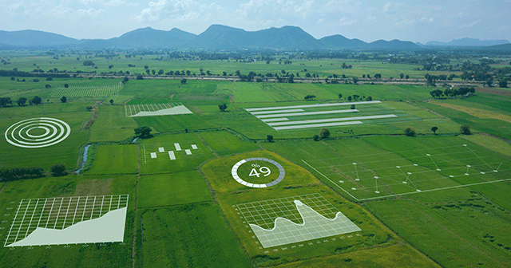
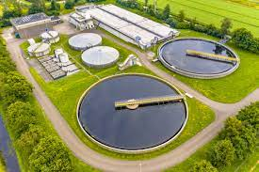
Steps Towards Circularity (3)
Precision agriculture. Novel technologies such as satelites, drones, multispectral sensors etc., facilitate farm management through the acquisition of real-time data by remote sensing. Farmers take calculated actions informed by the available data an, aiming to maximize resource efficiency, decrease economic and environmental cost.
Wastewater Use. Wastewater use is especially important in Mediterranean region where severe droughts are frequent. It has the potential to irrigate 15% of all irrigated land. The treated wastewater contains nitrogen and phosphorus, macronutrients required for plant growth. However, care must be taken in the frequency of application of treated wastewater to avoid the accumulation of heavy metals and harmful microorganism

Slide 14
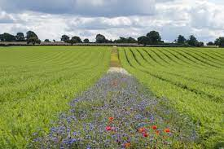
Steps Towards Circularity (4)
Maximum use of agrobiodiversity / Flower in the field edges
  Agrobiodiversity the variety and variability of crops, plants used in agriculture, and the interaction between their genetic resources the environment and management systems
  Agrobiodiversity acts as a natural defense against
  pest and diseases and supports the preservation
  of pollinators and endemic flora and fauna
  Flower in the field edges provide the necessary
  habitat for natural enemies that help
  to keep the pest damage below the economic threshold

Slide 15
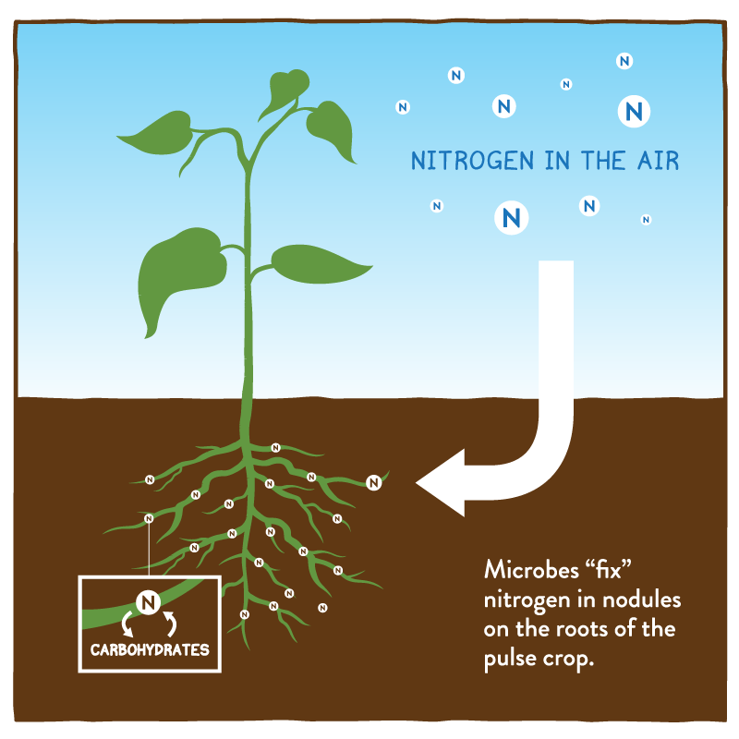
Steps Towards Circularity (5)
Soil health and organic material / Nitrogen fixing crops
  Maintaining an improving soil health can
  boost productivity and minimize unmarketable yield.
  Soil health contributes to the adequate nutrition of the plant with the necessary elements and water, minimizing non-marketable products (size deviation, elements deficiencies, distortions, etc).
  Organic material functions as a natural carbon sink and improves soil properties.
  The use of nitrogen fixing crops naturally adds nitrogen to the soil.

Slide 16
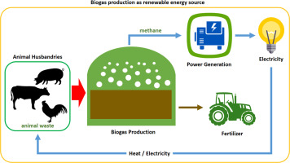
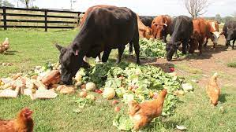
Circular Practices
1. Feeding livestock from food waste is also highly used as waste handling process in the agri-food industry. For example, the utilization of wheat co-products for animal feed.
2. Cow and pig farms can harvest the methane from animals for biogas production. Animal manure is stored under anaerobic conditions where microorganisms break down the organic manure producing biogas, mostly containing methane. The energy can be used for the farm operations. Biogas can be used for heating, electricity production and as vehicle fuel.

Slide 17
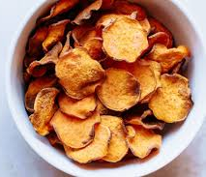
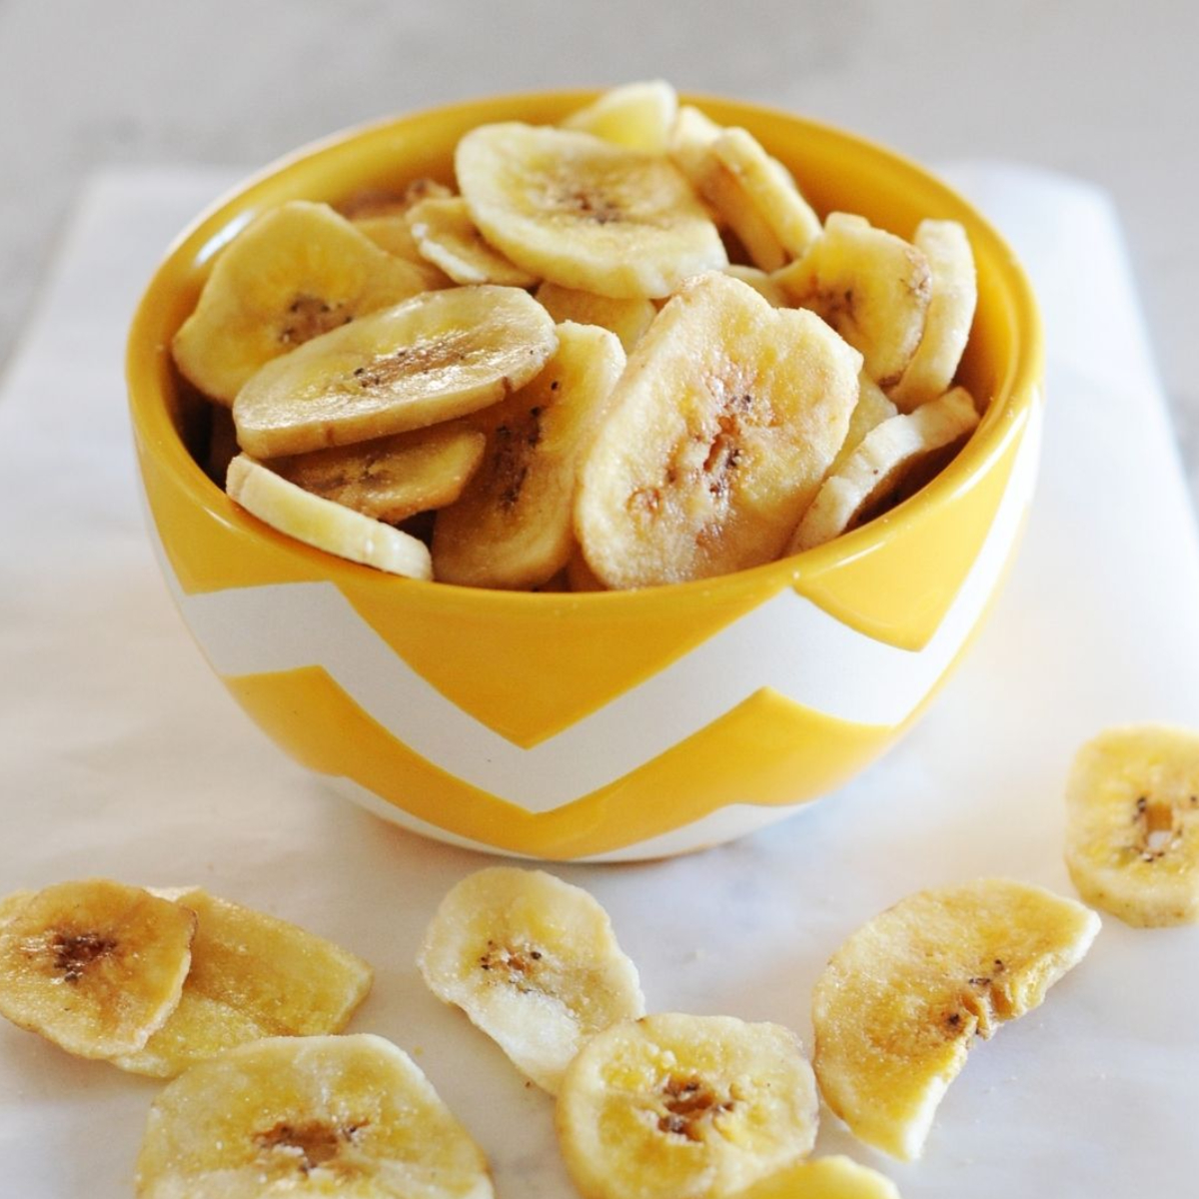
Circular Practices
3. Production of boxes intended for handling vegetables to supermarkets. Cellulosic rich crop residues are proved to be a useful alternative raw material to the pulp and paper industry. Cellulose is extracted from the fiber of tomato plant stems and used as raw material for the production of boxes. Other alternatives are rice husk, wheat husk, maize husk, pine needles, cotton.
4. Unmarketable vegetables and fruits can be processed to create edible food. For example, unmarketable potatoes are processed into fresh chips for the food industry. Oversized sweet potatoes and bananas can be sliced ​​and oven-dried to be sold as snacks.

Slide 18
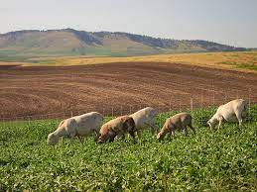
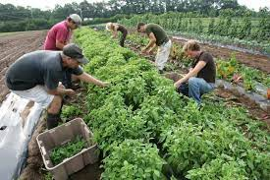
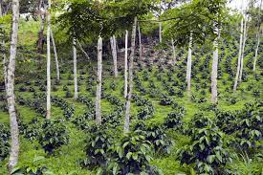
Current examples of circular agriculture
The concept of mixed crop-livestock farming. The manure produced by the livestock returns to the soil as a bio-fertilizer to regrow cover crops used as feed for the livestock.
Mixed Farming
Eliminate the use of chemical fertilizers, pesticides and plastics. Fertilizers are replaced by compost produced from crop residues or manure. Pest control is achieved with the use of living microorganisms and several practices that increase biodiversity. Labor intensive.
Organic Farming
Agroforestry
Tree planting in combination with crops or pastures. An interactive system of symbiosis. Trees provide shade to crops and grazing livestock can provide organic matter for the trees.

